Slide 1
Data Warehousing
Lecture 1-2: DW & Need for DW
Department of Computer Science

Slide 2
Course Objectives
At the end of the course you will (hopefully) be able to answer the questions
  Why exactly the world needs a data warehouse?
  How DW differs from traditional databases and RDBMS?
  Where does OLAP stands in the DW picture?
  What are different DW and OLAP models/schemas? How to implement and test these?
  How to perform ETL? What is data cleansing? How to perform it? What are the famous algorithms?
  Which different DW architectures have been reported in the literature? What are their strengths and weaknesses?
  What latest areas of research and development are stemming out of DW domain?

Slide 3
Course Book
  Paulraj Ponniah, Data Warehousing Fundamentals, John Wiley & Sons Inc., NY.
Reference Books
  W.H. Inmon, Building the Data Warehouse (Second Edition), John Wiley & Sons Inc., NY.
  Ralph Kimball and Margy Ross, The Data Warehouse Toolkit (Second Edition), John Wiley & Sons Inc., NY.

Slide 4
Assignments
Implementation/Research on important concepts.
To be submitted in groups of 2 students.
Include
  Modeling and Benchmarking of multiple warehouse schemas
  Implementation of an efficient OLAP cube generation algorithm
  Data cleansing and transformation of legacy data
  Literature Review paper on
    View Consistency Mechanisms in Data Warehouse
    Index design optimization
    Advance DW Applications
May add a couple more

Slide 5
Lab Work
Lab Exercises. To be submitted individually

Slide 6
Course Introduction
What this course is about?
  Decision Support Cycle
  Planning – Designing – Developing - Optimizing – Utilizing

Slide 7
Course Introduction
Information Sources
Data Warehouse
Server
(Tier 1)
OLAP Servers
(Tier 2)
Clients
(Tier 3)
e.g., MOLAP
Semistructured
Sources
Analysis
Data
Warehouse
serve
extract
transform
load
refresh
etc.
Query/Reporting
serve
e.g., ROLAP
Operational
DB’s
serve
Data Mining
Data Marts

Slide 8
Operational Sources (OLTP’s)
Operational computer systems did provide information to run day-to-day operations, and answer’s daily questions, but…
Also called online transactional processing system (OLTP)
Data is read or manipulated with each transaction
Transactions/queries are simple, and easy to write
Usually for middle management
Examples
  Sales systems
  Hotel reservation systems
  COMSIS
  HRM Applications
  Etc.

Slide 9
Typical decision queries
Data set are mounting everywhere, but not useful for decision support
Decision-making require complex questions from integrated data.
Enterprise wide data is desired
Decision makers want to know:
  Where to build new oil warehouse?
  Which market they should strengthen?
  Which customer groups are most profitable?
  How much is the total sale by month/ year/ quarter for each offices?
  Is there any relation between promotion campaigns and sales growth?
Can OLTP answer all such questions, ☹ efficiently?

Slide 10
Information crisis*
Integrated
  Must have a single, enterprise-wide view
Data Integrity
  Information must be accurate and must conform to business rules
Accessible
  Easily accessible with intuitive access paths and responsive for analysis
Credible
  Every business factor must have one and only one value
Timely
  Information must be available within the stipulated time frame
* Paulraj 2001.

Slide 11
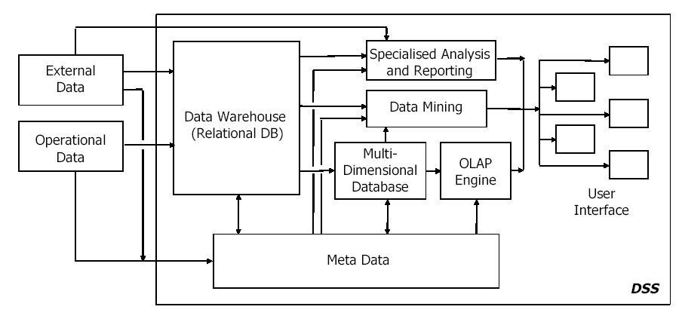
Data Driven-DSS*
* Farooq, lecture slides for ‘Data Warehouse’ course

Slide 12
Failure of old DSS
Inability to provide strategic information
IT receive too many ad hoc requests, so large over load
Requests are not only numerous, they change overtime
For more understanding more reports
Users are in spiral of reports
Users have to depend on IT for information
Can't provide enough performance, slow
Strategic information have to be flexible and conductive

Slide 13
OLTP vs. DSS
Trait | OLTP | DSS
User | Middle management | Executives, decision-makers
Function | For day-to-day operations | For analysis & decision support
DB (modeling) | E-R based, after normalization | Star oriented schemas
Data | Current, Isolated | Archived, derived, summarized
Unit of work | Transactions | Complex query
Access, type | DML, read | Read
Access frequency | Very high | Medium to Low
Records accessed | Tens to Hundreds | Thousands to Millions
Quantity of users | Thousands | Very small amount
Usage | Predictable, repetitive | Ad hoc, random, heuristic based
DB size | 100 MB-GB | 100GB-TB
Response time | Sub-seconds | Up-to min.s

Slide 14
Expectations of new soln.
DB designed for analytical tasks
Data from multiple applications
Easy to use
Ability of what-if analysis
Read-intensive data usage
Direct interaction with system, without IT assistance
Periodical updating contents & stable
Current & historical data
Ability for users to initiate reports

Slide 15
DW meets expectations
Provides enterprise view
Current & historical data available
Decision-transaction possible without affecting operational source
Reliable source of information
Ability for users to initiate reports
Acts as a data source for all analytical applications

Slide 16
Definition of DW
Inmon defined
“A DW is a subject-oriented, integrated, non-volatile, time-variant collection of data in favor of decision-making”.
Kelly said
“Separate available, integrated, time-stamped, subject-oriented, non-volatile, accessible”
  Four properties of DW

Slide 17
Subject-oriented
In operational sources data is organized by applications, or business processes.
In DW subject is the organization method
Subjects vary with enterprise
These are critical factors, that affect performance
Example of Manufacturing Company
  Sales
  Shipment
  Inventory etc

Slide 18
Integrated Data
Data comes from several applications
Problems of integration comes into play
  File layout, encoding, field names, systems, schema, data heterogeneity are the issues
  Bank example, variance: naming convention, attributes for data item, account no, account type, size, currency
In addition to internal, external data sources
  External companies data sharing
  Websites
  Others
Removal of inconsistency
So process of extraction, transformation & loading

Slide 19
Time variant
Operational data has current values
Comparative analysis is one of the best techniques for business performance evaluation
Time is critical factor for comparative analysis
Every data structure in DW contains time element
In order to promote product in certain, analyst has to know about current and historical values
The advantages are
  Allows for analysis of the past
  Relates information to the present
  Enables forecasts for the future

Slide 20
Non-volatile
Data from operational systems are moved into DW after specific intervals
Data is persistent/ not removed i.e. non volatile
Every business transaction don’t update in DW
Data from DW is not deleted
Data is neither changed by individual transactions
Properties summary
Subject Oriented
Time-Variant
Non-Volatile
Organized along the lines of the subjects of the corporation. Typical subjects are customer, product, vendor and transaction.
Every record in the data warehouse has some form of time variancy attached to it.
Refers to the inability of data to be updated. Every record in the data warehouse is time stamped in one form or another.

Slide 21
Lecture 2
DW Architecture & Dimension Modeling
Khurram Shahzad
mks@ciitlahore.edu.pk

Slide 22
Agenda
Data Warehouse architecture & building blocks
ER modeling review
Need for Dimensional Modeling
Dimensional modeling & its inside
Comparison of ER with dimensional

Slide 23
Architecture of DW
Information Sources
Data Warehouse
Server
(Tier 1)
OLAP Servers
(Tier 2)
Clients
(Tier 3)
e.g., MOLAP
Analysis
Semistructured
Sources
Data
Warehouse
serve
extract
transform
load
refresh
Query/Reporting
serve
e.g., ROLAP
Operational
DB’s
serve
Data Mining
Staging area
Data Marts

Slide 24
Components
Major components
  Source data component
  Data staging component
  Information delivery component
  Metadata component
  Management and control component

Slide 25
1. Source Data Components
Source data can be grouped into 4 components
  Production data
    Comes from operational systems of enterprise
    Some segments are selected from it
    Narrow scope, e.g. order details
  Internal data
    Private datasheet, documents, customer profiles etc.
    E.g. Customer profiles for specific offering
    Special strategies to transform ‘it’ to DW (text document)
  Archived data
    Old data is archived
    DW have snapshots of historical data
  External data
    Executives depend upon external sources
    E.g. market data of competitors, car rental require new manufacturing. Define conversion

Slide 26
Architecture of DW
Information Sources
Data Warehouse
Server
(Tier 1)
OLAP Servers
(Tier 2)
Clients
(Tier 3)
e.g., MOLAP
Analysis
Semistructured
Sources
Data
Warehouse
serve
extract
transform
load
refresh
Query/Reporting
serve
e.g., ROLAP
Operational
DB’s
serve
Data Mining
Staging area
Data Marts

Slide 27
2. Data Staging Components
After data is extracted, data is to be prepared
Data extracted from sources needs to be changed, converted and made ready in suitable format
Three major functions to make data ready
  Extract
  Transform
  Load
Staging area provides a place and area with a set of functions to
  Clean
  Change
  Combine
  Convert

Slide 28
Architecture of DW
Information Sources
Data Warehouse
Server
(Tier 1)
OLAP Servers
(Tier 2)
Clients
(Tier 3)
e.g., MOLAP
Analysis
Semistructured
Sources
Data
Warehouse
serve
extract
transform
load
refresh
Query/Reporting
serve
e.g., ROLAP
Operational
DB’s
serve
Data Mining
Staging area
Data Marts

Slide 29
3. Data Storage Components
Separate repository
Data structured for efficient processing
Redundancy is increased
Updated after specific periods
Only read-only

Slide 30
Architecture of DW
Information Sources
Data Warehouse
Server
(Tier 1)
OLAP Servers
(Tier 2)
Clients
(Tier 3)
e.g., MOLAP
Analysis
Semistructured
Sources
Data
Warehouse
serve
extract
transform
load
refresh
Query/Reporting
serve
e.g., ROLAP
Operational
DB’s
serve
Data Mining
Staging area
Data Marts

Slide 31
4. Information Delivery Component
Authentication issues
Active monitoring services
  Performance, DBA note selected aggregates to change storage
  User performance
  Aggregate awareness
  E.g. mining, OLAP etc

Slide 32
DW Design

Slide 33
Designing DW
Information Sources
Data Warehouse
Server
(Tier 1)
OLAP Servers
(Tier 2)
Clients
(Tier 3)
e.g., MOLAP
Analysis
Semistructured
Sources
Data
Warehouse
serve
extract
transform
load
refresh
Query/Reporting
serve
e.g., ROLAP
Operational
DB’s
serve
Data Mining
Staging area
Data Marts

Slide 34
Background (ER Modeling)
For ER modeling, entities are collected from the environment
Each entity act as a table
Success reasons
  Normalized after ER, since it removes redundancy (to handle update/delete anomalies)
    But number of tables is increased
  Is useful for fast access of small amount of data

Slide 35
ER Drawbacks for DW / Need of Dimensional Modeling
  ER Hard to remember, due to increased number of tables
  Complex for queries with multiple tables (table joins)
  Conventional RDBMS optimized for small number of tables whereas large number of tables might be required in DW
  Ideally no calculated attributes
  The DW does not require to update data like in OLTP system so there is no need of normalization
  OLAP is not the only purpose of DW, we need a model that facilitate integration of data, data mining, historically consolidated data.
  Efficient indexing scheme to avoid screening of all data
  De-Normalization (in DW)
  Add primary key
  Direct relationships
  Re-introduce redundancy

Slide 36
Dimensional Modeling
Dimensional Modeling focuses subject-orientation, critical factors of business
Critical factors are stored in facts
Redundancy is no problem, achieve efficiency
Logical design technique for high performance
Is the modeling technique for storage

Slide 37
Dimensional Modeling (cont.)
Two important concepts
  Fact
    Numeric measurements, represent business activity/event
    Are pre-computed, redundant
    Example: Profit, quantity sold
  Dimension
    Qualifying characteristics, perspective to a fact
    Example: date (Date, month, quarter, year)

Slide 38
Dimensional Modeling (cont.)
Facts are stored in fact table
Dimensions are represented by dimension tables
Dimensions are degrees in which facts can be judged
Each fact is surrounded by dimension tables
Looks like a star so called Star Schema

Slide 39
Example
PRODUCT
product_key (PK)
SKU
description
brand
category
TIME
time_key (PK)
SQL_date
day_of_week
month
FACT
time_key (FK)
store_key (FK)
clerk_key (FK)
product_key (FK)
customer_key (FK)
promotion_key (FK)
dollars_sold
units_sold
dollars_cost
STORE
store_key (PK)
store_ID
store_name
address
district
floor_type
CUSTOMER
customer_key (PK)
customer_name
purchase_profile
credit_profile
address
CLERK
clerk_key (PK)
clerk_id
clerk_name
clerk_grade
PROMOTION
promotion_key (PK)
promotion_name
price_type
ad_type

Slide 40
Inside Dimensional Modeling
Inside Dimension table
  Key attribute of dimension table, for identification
  Large no of columns, wide table
  Non-calculated attributes, textual attributes
  Attributes are not directly related
  Un-normalized in Star schema
  Ability to drill-down and drill-up are two ways of exploiting dimensions
  Can have multiple hierarchies
  Relatively small number of records

Slide 41
Inside Dimensional Modeling
Have two types of attributes
  Key attributes, for connections
  Facts
Inside fact table
  Concatenated key
  Grain or level of data identified
  Large number of records
  Limited attributes
  Sparse data set
  Degenerate dimensions (order number→ Average products per order)
Fact-less fact table

Slide 42
Star Schema Keys
Primary keys
  Identifying attribute in dimension table
  Relationship attributes combine together to form P.K
Surrogate keys
  Replacement of primary key
  System generated
Foreign keys
  Collection of primary keys of dimension tables
Primary key to fact table
  System generated
  Collection of P.Ks

Slide 43
Advantage of Star Schema
Ease for users to understand
Optimized for navigation (less joins →fast)
Most suitable for query processing
Karen Corral, et al. (2006) The impact of alternative diagrams on the accuracy of recall: A comparison of star-schema diagrams and entity-relationship diagrams, Decision Support Systems, 42(1), 450-468.

Slide 44
Normalization [1]
“It is the process of decomposing the relational table in smaller tables.”
Normalization Goals:
Remove data redundancy
Storing only related data in a table (data dependency makes sense)
5 Normal Forms
The decomposition must be lossless

Slide 45
1st Normal Form [2]
“A relation is in first normal form if and only if every attribute is single-valued for each tuple”
STU_ID | STU_NAME | MAJOR | CREDITS | CATEGORY
S1001 | Tom Smith | History | 90 | Comp
S1003 | Mary Jones | Math | 95 | Elective
S1006 | Edward Burns | CSC, Math | 15 | Comp, Elective
S1010 | Mary Jones | Art, English | 63 | Elective, Elective
S1060 | John Smith | CSC | 25 | Comp

Slide 46
1st Normal Form (Cont.)
STU_ID | STU_NAME | MAJOR | CREDITS | CATEGORY
S1001 | Tom Smith | History | 90 | Comp
S1003 | Mary Jones | Math | 95 | Elective
S1006 | Edward Burns | CSC | 15 | Comp
S1006 | Edward Burns | Math | 15 | Elective
S1010 | Mary Jones | Art | 63 | Elective
S1010 | Mary Jones | English | 63 | Comp
S1060 | John Smith | CSC | 25 | Comp

Slide 47
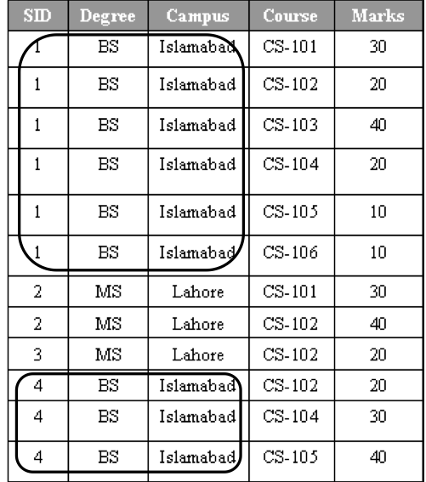
Another Example (composite key: SID, Course) [1]

Slide 48
1st Normal Form Anomalies [1]
Update anomaly: Need to update all six rows for student with ID=1if we want to change his location from Islamabad to Karachi
Delete anomaly: Deleting the information about a student who has graduated will remove all of his information from the database
Insert anomaly: For inserting the information about a student, that student must be registered in a course

Slide 49
Solution → 2nd Normal Form
“A relation is in second normal form if and only if it is in first normal form and all the nonkey attributes are fully functional dependent on the key” [2]
In previous example, functional dependencies [1]
SID —> campus
Campus→ degree

Slide 50
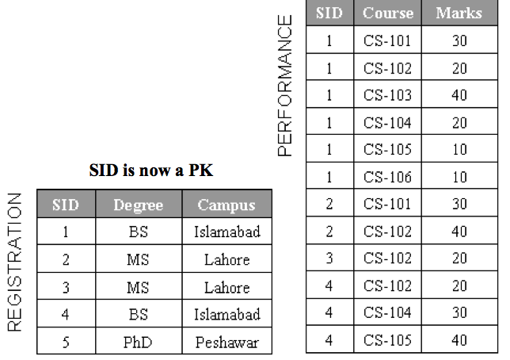
Example in 2nd Normal Form [1]

Slide 51
Anomalies [1]
Insert Anomaly: Can not enter a program for example PhD for Peshawar campus unless a student get registered
Delete Anomaly: Deleting a row from “Registration” table will delete all information about a student as well as degree program

Slide 52
Solution → 3rd Normal Form
“A relation is in third normal form if it is in second normal form and nonkey attribute is transitively dependent on the key” [2]
In previous example: [1]
Campus→ degree

Slide 53
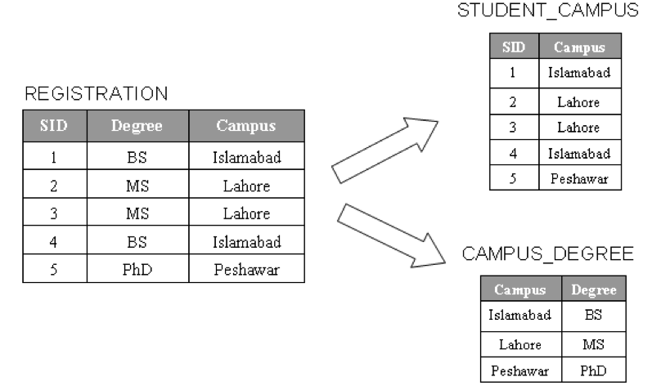
Example in 3rd Normal Form [1]

Slide 54
Denormalization [1]
“Denormanlization is the process” to selectively transforms the normalized relations in to un-normalized form with the intention to “reduce query processing time”
The purpose is to reduce the number of tables to avoid the number of joins in a query

Slide 55
Five techniques to denormalize relations [1]
Collapsing tables
Pre-joining
Splitting tables (horizontal, vertical)
Adding redundant columns
Derived attributes

Slide 56
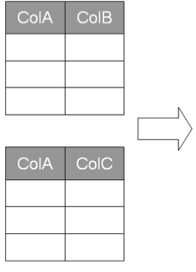
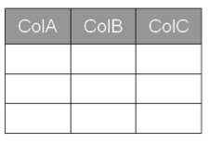
Collapsing tables (one-to-one) [1]
For example, Student_ID, Gender in Table 1 and
Student_ID, Degree in Table 2

Slide 57
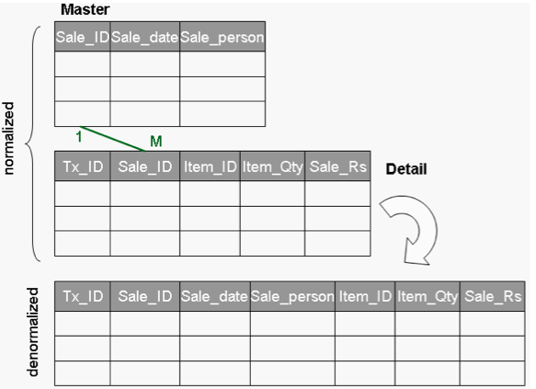
Pre-joining [1]

Slide 58
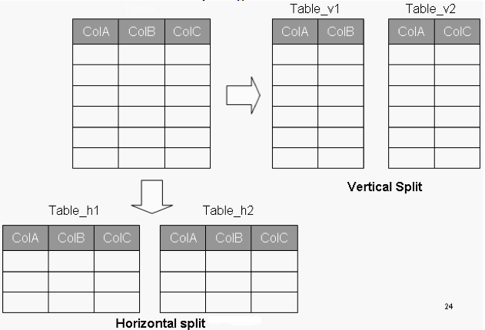
Splitting tables [1]

Slide 59
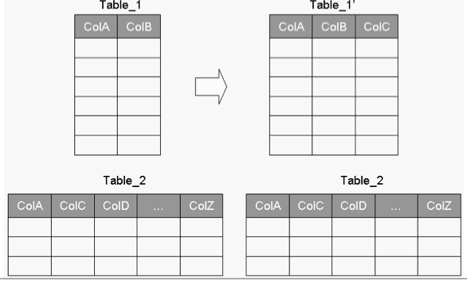
Redundant columns [1]

Slide 60
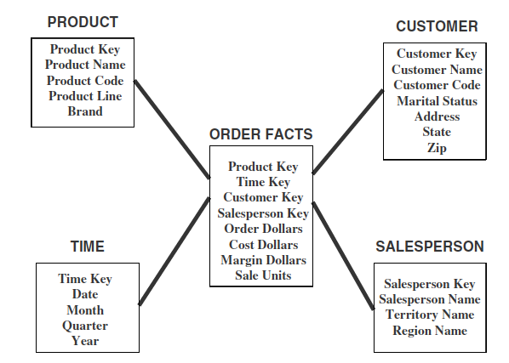
Updates to Dimension Tables

Slide 61
Updates to Dimension Tables (Cont.)
Type-I changes: correction of errors, e.g., customer name changes from Sulman Khan to Salman Khan
Solution to type-I updates:
  Simply update the corresponding attribute/attributes. There is no need to preserve their old values

Slide 62
Updates to Dimension Tables (Cont.)
Type 2 changes: preserving history
For example change in “address” of a customer, but the user wants to see orders by geographic location then you can not simply update the address by replacing old value with new value, you need to preserve the history (old value) as well as need to insert new value

Slide 63
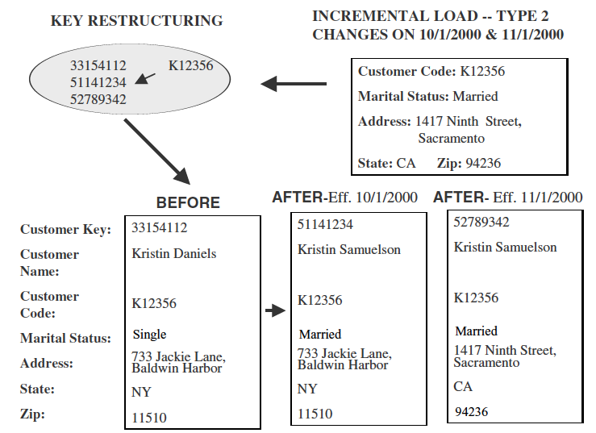
Updates to Dimension Tables (Cont.)
Proposed solution:

Slide 64
Updates to Dimension Tables (Cont.)
Type 3 changes: When you want to compare old and new values of attributes for a given period
Please note that in Type 2 changes the old values and new values were not comparable before or after the cut-off date (when the address was changed)

Slide 65
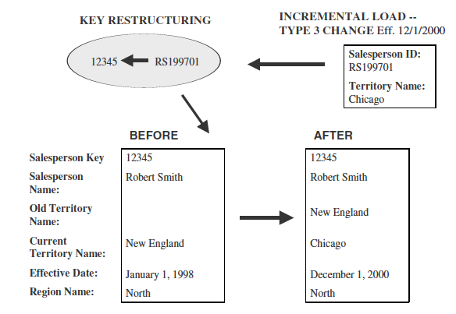
Updates to Dimension Tables (Cont.)
Solution: Add a new column of attribute

Slide 66
Updates to Dimension Tables (Cont.)
What if we want to keep a whole history of changes?
Should we add large number of attributes to tackle it?

Slide 67
Rapidly Changing Dimension
When dimension’s records/rows are very large in numbers and changes are required frequently then Type-II change handling is not recommended
It is recommended to make a separate table of rapidly changing attributes

Slide 68
Rapidly Changing Dimension (Cont.)
“For example, an important attribute for customers might be their account status (good, late, very late, in arrears, suspended), and the history of their account status” [4]
“If this attribute is kept in the customer dimension table and a type 2 change is made each time a customer's status changes, an entire row is added only to track this one attribute” [4]
“The solution is to create a separate account_status dimension with five members to represent the account states” [4] and join this new table or dimension to the fact table.

Slide 69
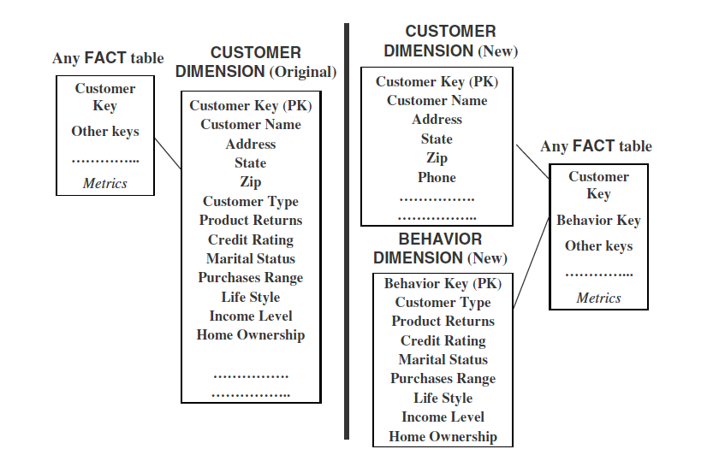
Example

Slide 70
Junk Dimensions
Sometimes there are some informative flags and texts in the source system, e.g., yes/no flags, textual codes, etc.
If such flags are important then make their own dimension to save the storage space

Slide 71
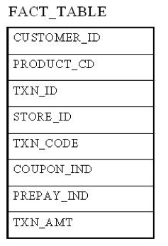
Junk Dimension Example [3]

Slide 72
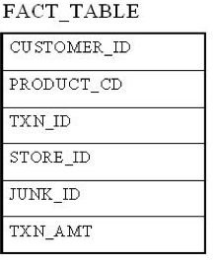
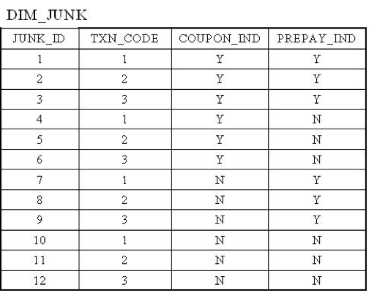
Junk Dimension Example (Cont.) [3]

Slide 73
The Snowflake Schema
Snowflacking involves normalization of dimensions in Star Schema
Reasons:
To save storage space
To optimize some specific quires (for attributes with low cardinality)

Slide 74
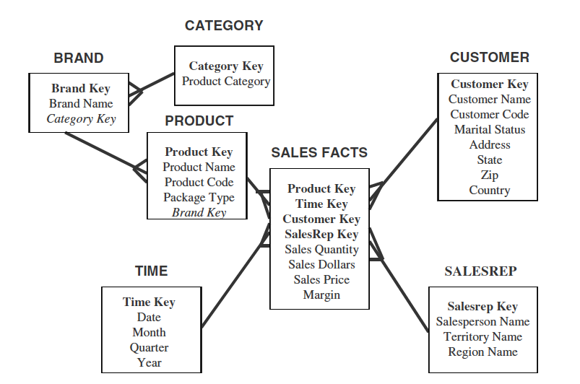
Example 1 of Snowflake Schema

Slide 75
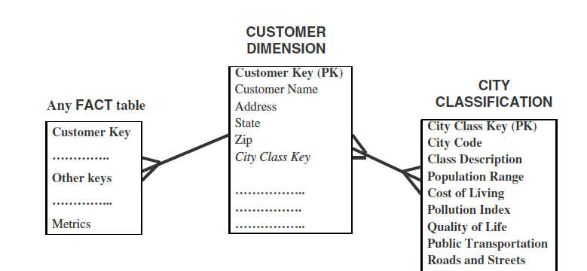
Example 2 of Snowflake Schema

Slide 76
Aggregate Fact Tables
Use aggregate fact tables when too many rows of fact tables are involved in making summary of required results
Objective is to reduce query processing time

Slide 77
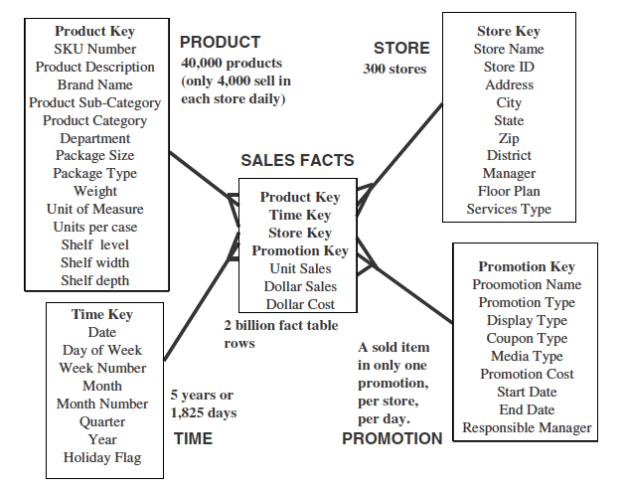
Example
Total Possible Rows = 1825 * 300 * 4000 * 1 = 2 billion

Slide 78
Solution
Make aggregate fact tables, because you might be summing some dimension and some might not then why we should store the dimensions that do not need highest level of granularity of details.
For example: Sales of a product in a year OR
total number of items sold by category on daily basis

Slide 79
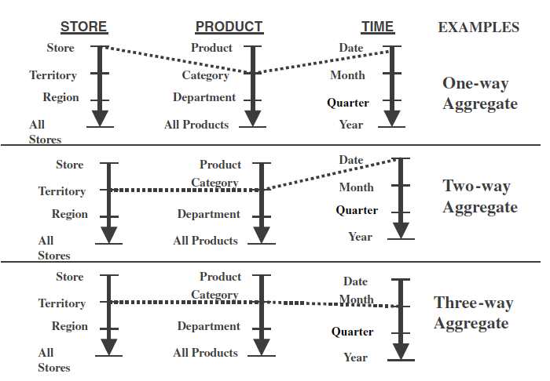
A way of making aggregates
Example:

Slide 80
Making Aggregates
But first determine what is required from your data warehouse then make aggregates

Slide 81
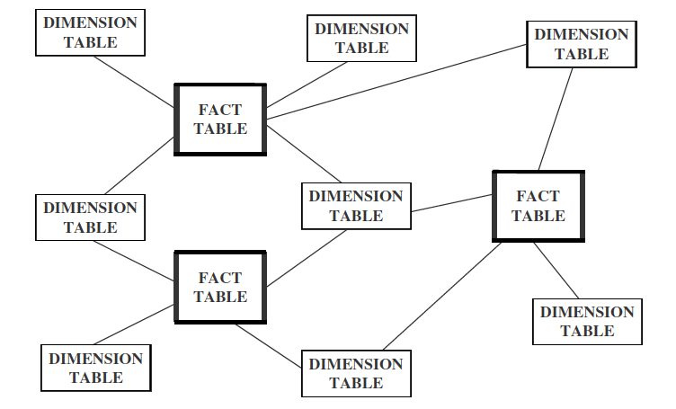
Families of Stars

Slide 82
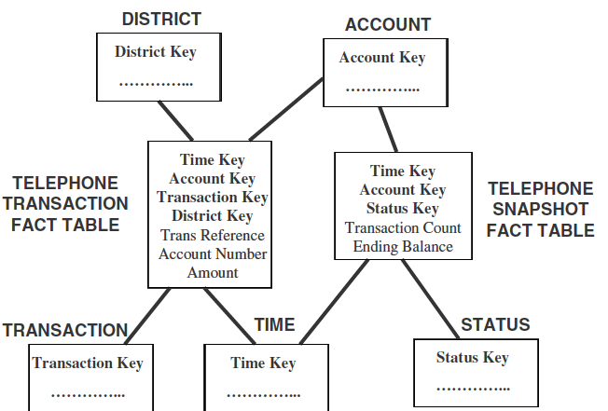
Families of Stars (Cont.)
Transaction (day to day) and snapshot tables (data after some specific intervals)

Slide 83
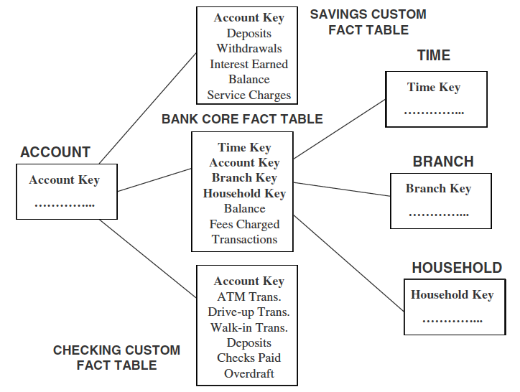
Families of Stars (Cont.)
Core and custom tables

Slide 84
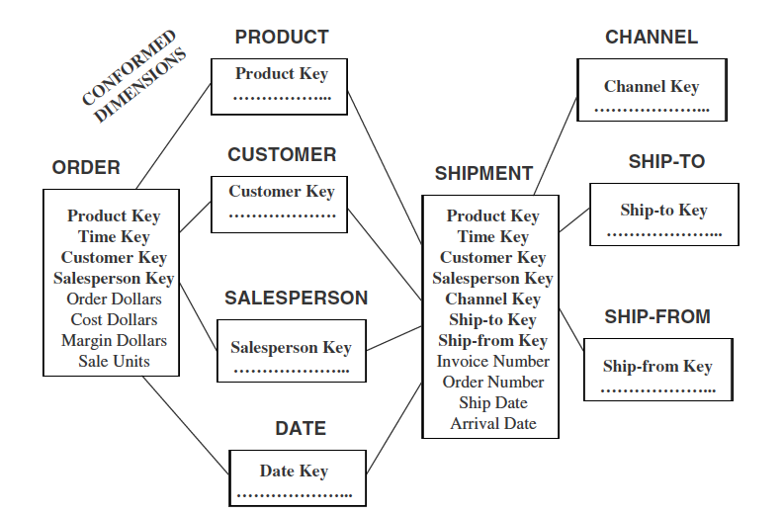
Families of Stars (Cont.)
Conformed Dimension: The attributes of a dimension must have the same meaning for all those fact tables with which the dimension is connected.

Slide 85
Extract, Transform, Load (ETL)
Extract only relevant data from the internal source systems or external systems, instead of dumping all data (“data junkhouse”)
The ETL completion can take up to 50-70% of your total effort while developing a data warehouse.
These ETL efforts depends on various factors which will be elaborated as we proceed in our lectures regarding ETL.

Slide 86
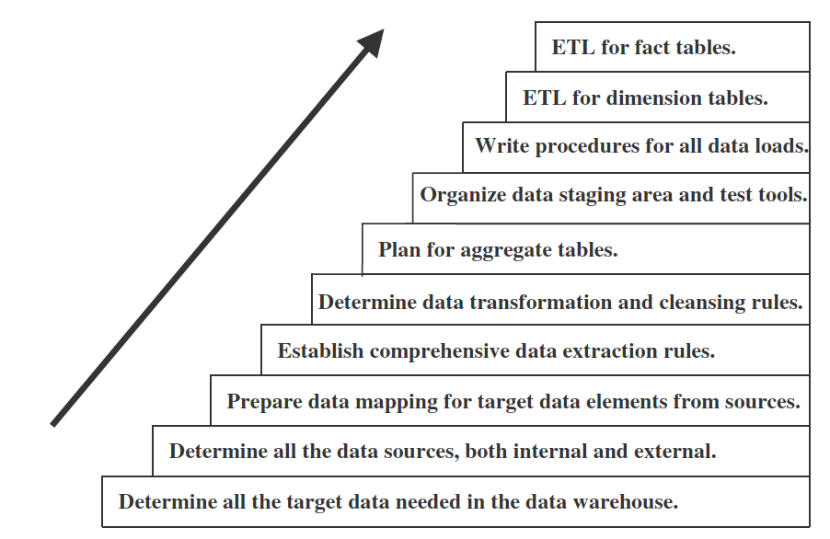
Major steps in ETL

Slide 87
Data Extraction
Data can be extracted using third party tools or in-house programs or scripts
Data extraction issues:
Identify sources
Method of extraction for each source (manual, automated)
When and how much frequently data will be extracted for each source
Time window
Sequencing of extraction processes

Slide 88
How data is stored in operational systems
Current value: Values continue to changes as daily transactions are performed. We need to monitor these changes to maintain history for decision making process, e.g., bank balance, customer address, etc.
Periodic status: sometimes the history of changes is maintained in the source system

Slide 89
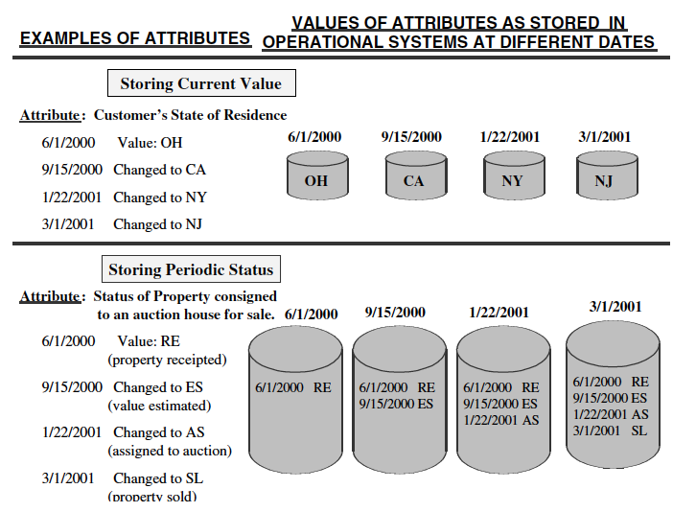
Example

Slide 90
Data Extraction Method
Static data extraction:
Extract the data at a certain time point.
It will include all transient data and periodic data along with its time/date status at the extraction time point
Used for initial data loading
Data of revisions
Data is loaded in increments thus preserving history of both changing and periodic data

Slide 91
Incremental data extraction
Immediate data extraction: involves data extraction in real time.
Possible options:
Capture through transactions logs
Make triggers/Stored procedures
Capture via source application
Capture on the basis of time and date stamps
Capture by comparing files

Slide 92
Data Transformation
Transformation means to integrate or consolidate data from various sources
Major tasks:
Format conversions (change in data type, length)
Decoding of fields (1,0 → male, female)
Calculated and derived values (units sold, price, cost→ profit)
Splitting of single fields (House no 10, ABC Road, 54000, Lahore, Punjab, Pakistan)
Merging of information (information from different sources regarding any entity, attribute)
Character set conversion

Slide 93
Data Transformation (Cont.)
Conversion of unit of measures
Date/time conversion
Key restructuring
De-duplication
Entity identification
Multiple source problem

Slide 94
Data Loading
Determine when (time) and how (as a whole or in chunks) to load data
Four modes to load data
Load: removes old data if available otherwise load data
Append: The old data is not removed, the new data is appended with the old data
Destructive Merge: If primary key of the new record matched with the primary key of and old record then update old record
Constructive Merge: If primary key of the new record matched with the primary key of and old record then do not update old record just add the new record and mark it as superseding record

Slide 95
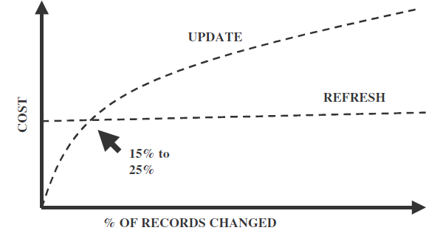
Data Loading (Cont.)
Data Refresh Vs. Data Update
Full refresh reloads whole data after deleting old data and data updates are used to update the changing attributes

Slide 96
Data Loading (Cont.)
Loading for dimensional tables: You need to define a mapping between source system key and system generated key in data warehouse, otherwise you will not be able to load/update data correctly

Slide 97
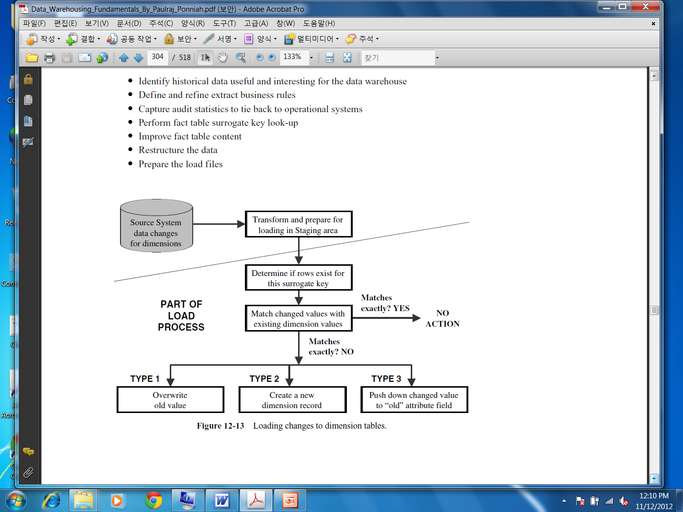
Data Loading (Cont.)
Updates to dimension table

Slide 98
Data Quality Management
It is important to ensure that the data is correct to make right decisions
Imagine the user working on operational system is entering wrong regions’ codes of customers. Imagine that the relevant business has never sent an invoice using these regions codes (so they are ignorant). But what will happen if the data warehouse will use these codes to make decisions?
You need to put proper time and effort to ensure data quality

Slide 99
Data Quality
What is Data: An abstraction/representation/
description of something in reality
What is Data Quality: Accuracy + Data must serve its purpose/user expectations

Slide 100
Indicators of quality of data
Accuracy: Correct information, e.g., address of the customer is correct
Domain Integrity: Allowable values, e.g., male/female
Consistency: The content and its form is same across all source system, e.g., product code of a product ABC in one system is 1234 then in other system it must be 1234 for that particular product

Slide 101
Indicators of quality of data (Cont.)
Redundancy: Data is not redundant, if for some reason for example efficiency the data is redundant then it must be identified accordingly
Completeness: There are no missing values in any field
Conformance to Business rules: Values are according to the business constraints, e.g., loan issued cannot be negative
Well defined structure: Whenever the data item can be divided in components it must be stored in terms of components/well structure, e.g., Muhammad Ahmed Khan can be structured as first name, middle name, last name. Similar is the case with addresses

Slide 102
Indicators of quality of data (Cont.)
Data Anomaly: Fields must contain that value for which it was created, e.g., State filed cannot take the city name
Proper Naming convention
Timely: timely data updates as required by user
Usefulness: The data elements in data warehouse must be useful and fulfill the requirements of the users otherwise data warehouse is not of any value

Slide 103
Indicators of quality of data (Cont.)
Entity and Referential Integrity: Entity integrity means every table must have a primary key and it must be unique and not null. Referential integrity enforces parent child relationship between tables, you can not insert a record in child table unless you have a corresponding record in parent table

Slide 104
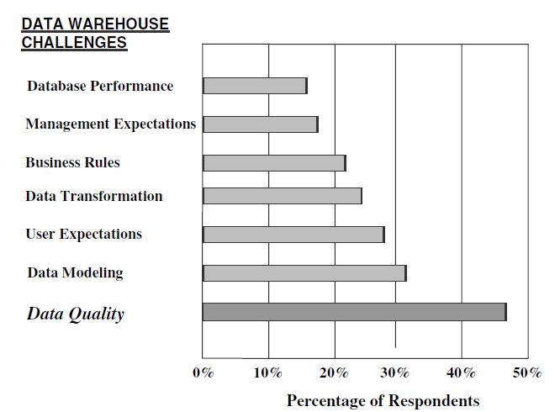
Problems due to quality of data
Businesses ranked data quality as the biggest problem during data warehouse designing and usage

Slide 105
Possible causes of low quality data
Dummy values: For example, to pass a check on postal code, entering dummy or not precise information such as 4444 (dummy) or 54000 for all regions of Lahore
Absence of data values: For example not a complete address
Unofficial use of field: For example writing comments in the contact field of the customer

Slide 106
Possible causes of low quality data
Cryptic Information: At one time operation system was using ‘R’ for “remove” then later for “reduced” and some other time point for “recovery”
Contradicting values: compatible fields must not contradict, e.g., two fields ZIP code and City can have values 54000 and Lahore but not some other city name for ZIP code 54000

Slide 107
Possible causes of low quality data
Violation of business rule: Issued loan is negative
Reused primary keys: For example, a business has 2 digit primary key. It can have maximum 100 customers. When a 101th customer comes the business might archive the old customers and assign the new customer a primary key from the start. It might not be a problem for the operation system but you need to resolve such issues because DW keeps historical data.

Slide 108
Possible causes of low quality data
Non-unique identifiers: For example different product codes in different departments
Inconsistent values: one system is using male/female to represent gender while other system is using 1/0
Incorrect values: Product Code: 466, Product Name: “Crystal vas”, Height:”500 inch”. It means that product and height values are not compatible. Either product name or height is wrong or maybe the product code as well

Slide 109
Possible causes of low quality data
Erroneous integration: A person might be a buyer or seller to your business. Your customer table might be storing such person with ID 222 while in seller table it might be 500. In data warehouse you might need to integrate this information. The persons with IDs 222 in both tables might not be same

Slide 110
Sources of data pollution
System migration or conversions: For example, from manual system→ Flat files → Hierarchal databases → relational databases….
Integration of heterogeneous systems: More heterogeneity means more problems
Poor database design: For example lack of business rules, lack of entity and referential integrity

Slide 111
Sources of data pollution (Cont.)
Incomplete data entry: For example, no city information
Wrong information during entry: For example United Kingdom → Unted Kingdom

Slide 112
Questions?

Slide 113
References
[1] Abdullah, A.: “Data warehousing handouts”, Virtual University of Pakistan
[2] Ricardo, C. M.: “Database Systems: Principles Design and Implementation”, Macmillan Coll Div.
[3] Junk Dimension, http://www.1keydata.com/datawarehousing/junk-dimension.html
[4] Advanced Topics of Dimensional Modeling https://mis.uhcl.edu/rob/Course/DW/Lectures/Advanced%20Dimensional%20Modeling.pdf

